Slide 1
LLM-Based Predictive Modeling for Traffic Flow Optimization Using Real-Time Social Media Data
Dissertation I
Priom Dutta
Guided by, Dr. Tapan Kumar Das
SCORE, VIT University — Vellore, India

Slide 2
Project overview
Real-time traffic congestion prediction using social media (Twitter/X) data.
Hybrid approach combining LLM-based semantic embeddings and LSTM predictive modeling.
Focus on identifying traffic severity levels: Low, Medium, High.
Utilizes ~6000–6500 real-time traffic-related tweets collected via RapidAPI.
Provides predictions, delay estimates, and visual insights through an interactive Streamlit dashboard.

Slide 3
Problem statement
Traditional traffic monitoring systems rely on sensors and cameras, which are costly and limited in coverage.
Social media users frequently report accidents, jams, and road blocks, but this data is unstructured and noisy.
Existing models fail to capture the contextual meaning of tweets due to limited semantic understanding.
There is a need for a system that can process real-time tweets, understand their context, and accurately predict traffic congestion levels.
The challenge lies in integrating LLM embeddings with predictive models to generate reliable, real-time traffic insights.

Slide 4
Objectives
Extract meaningful traffic-related information from real-time social media tweets.
Generate semantic embeddings using all-MiniLM-L6-v2 for contextual understanding.
Cluster tweets into meaningful groups such as low, medium, and high congestion.
Build a Hybrid LLM + LSTM model to predict traffic congestion levels accurately.
Estimate approximate traffic delay for end-users based on prediction output.
Visualize predictions and congestion hotspots through an interactive Streamlit dashboard.

Slide 5
Motivation
Growing reliance on social media platforms for instant reporting of accidents, roadblocks, and traffic jams.
Traditional traffic systems lack real-time coverage, especially in rapidly developing urban areas.
Social media provides rich, crowd-sourced, real-time data that can improve traffic awareness.
LLMs enable deeper semantic understanding of tweets beyond simple keyword matching.
A predictive traffic model can aid commuters, authorities, and smart city planners in decision-making and route optimization.

Slide 6
Related works
Use of Large Language Models (LLMs) for explainable traffic flow prediction, demonstrating the value of semantic understanding in traffic-related text
Application of Machine Learning algorithms such as Random Forest, SVM, and k-NN for traffic flow estimation in smart traffic systems.
Adoption of Big Data analytics and Deep Learning models, including neural networks and statistical forecasting methods, for intelligent transportation systems.
Use of LSTM and CNN-LSTM hybrid networks to analyze real-time social media text for traffic prediction tasks.
Implementation of Convolutional Neural Networks (CNNs) on time–space traffic diagrams to model vehicle movement and predict congestion patterns.

Slide 7
Proposed system overview
System processes real-time tweets to extract traffic-related insights using LLM-based semantic embeddings.
Embeddings combined with structured features (time, sentiment, location) to form a comprehensive feature set.
Clustering (HDBSCAN, K-Means) used to group tweets into Low, Medium, and High congestion categories.
A Hybrid LLM + LSTM model predicts traffic congestion level from processed features.
An interactive Streamlit dashboard displays congestion prediction, delay estimation, and map visualizations.

Slide 8
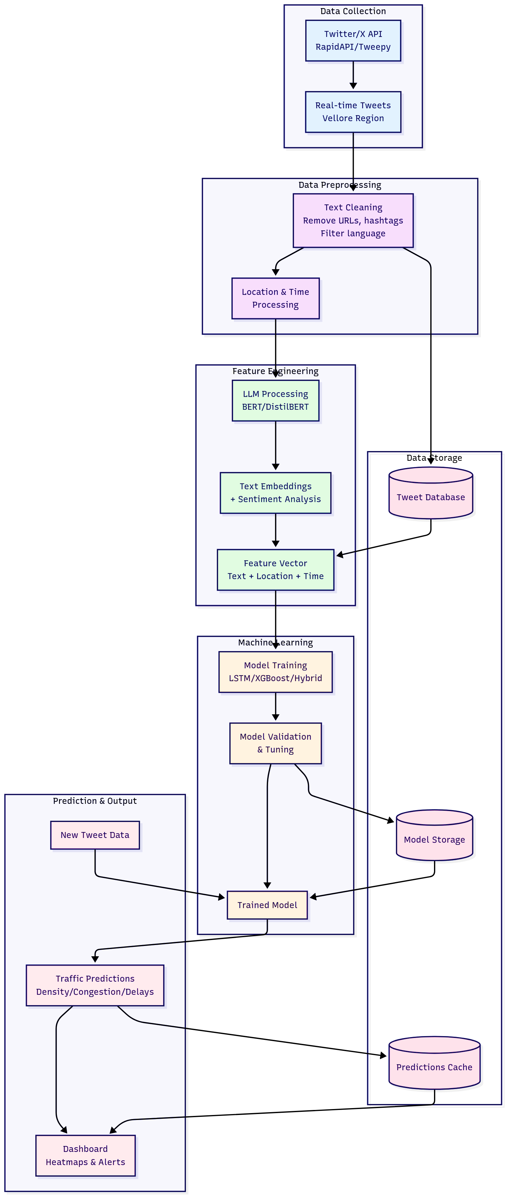
System architecture

Slide 9
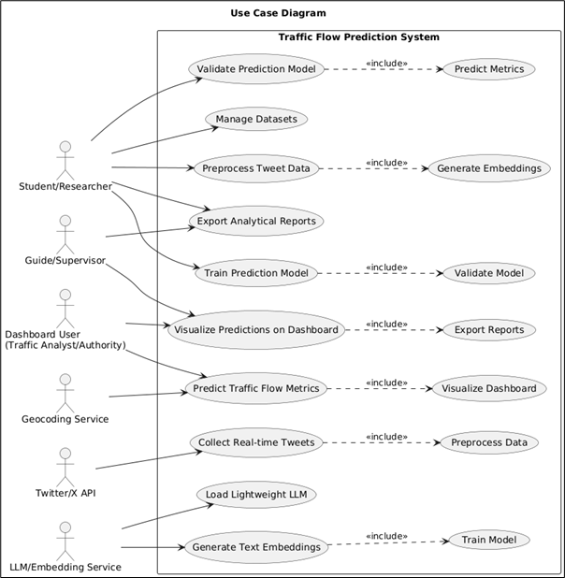
Use-case diagram

Slide 10
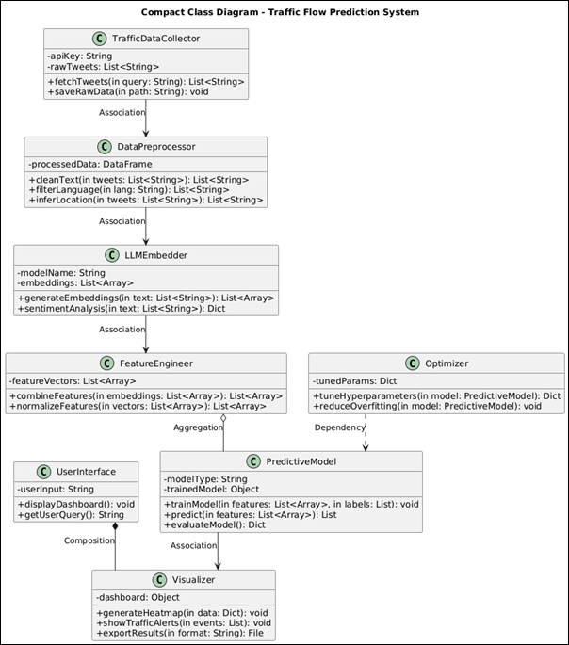
Uml class diagram

Slide 11
Dataset description
Collected 6000–6500 real-time traffic-related tweets using RapidAPI (Twitter/X).
Dataset includes fields such as:
tweet_id
raw_text_tweet
created_at
user_location
retweet_count, like_count
Tweets cover diverse conditions: accidents, roadblocks, jams, and smooth traffic.

Slide 12
Dataset preprocessing
Preprocessing steps: removed hashtags/mentions/URLs, filtered English-language tweets, inferred location/geotag.
Generated structured features: sentiment score, timestamp components (hour/day/weekday/month), location (latitude/longitude).
Embeddings generated using all-MiniLM-L6-v2 to convert raw text into 384-dimensional vectors.

Slide 13
Embedding generation
Used all-MiniLM-L6-v2 from SentenceTransformers for semantic text embedding.
Converts raw tweets into 384-dimensional vector representations capturing context and meaning.
Handles informal language, abbreviations, and noisy tweet text better than traditional NLP methods.
Generated embeddings serve as the base feature set for clustering and model training.
Enables distinction between similar phrases, e.g., “road blocked” vs. “heavy jam” vs. “accident occurred”.

Slide 14
Clustering(hdbscan & Kmeans)
HDBSCAN used for density-based clustering to identify natural tweet groupings without fixing the number of clusters.
Effectively separates dense semantic regions and labels outliers as noise.
K-Means applied with k=3 to partition tweets into Low, Medium, and High congestion groups.
Helps validate embedding quality by visualizing tweet distribution in reduced-dimensional space.
Provides cluster labels that support downstream prediction and model training.

Slide 15
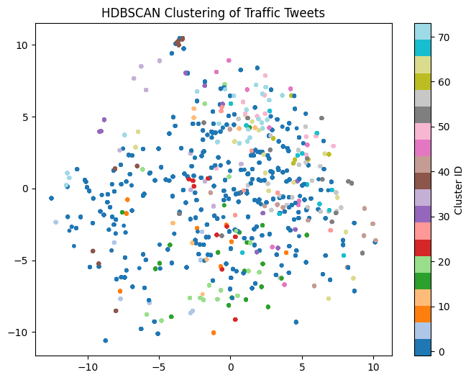
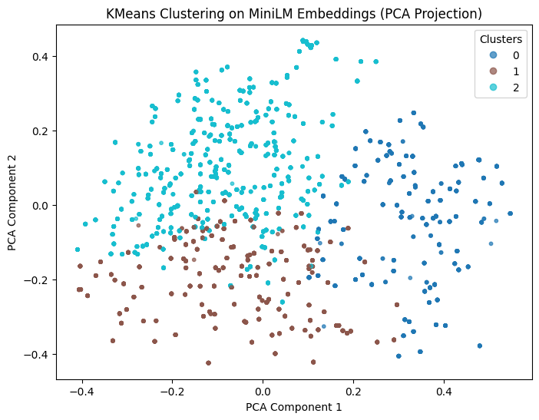
Clustering visualizations

Slide 16
Feature Engineering
LLM Embeddings (MiniLM-L6-v2):
Each tweet converted into a dense 384-dimensional semantic vector capturing context, intent, and traffic-related meaning.
Structured Features Added:
Extracted auxiliary information to enhance prediction accuracy, such as:
Tweet sentiment and polarity
Latitude & longitude (geotag approximation)
Time features (hour, day, weekday, month)
Keyword indicators (e.g., crash, jam, blocked)
Combined Feature Matrix:
Merged embeddings + structured features into a unified input vector aligned with the LSTM model shape.
Final Input Shape for Hybrid Model:
Standardized to match LSTM’s expected 392-dimensional input.
Purpose:
Ensures the model learns from both semantic understanding (LLM) and contextual traffic factors to improve prediction accuracy.

Slide 17
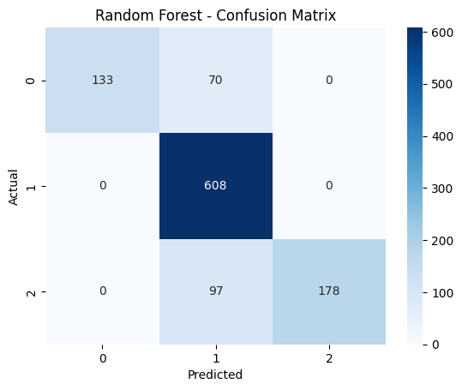
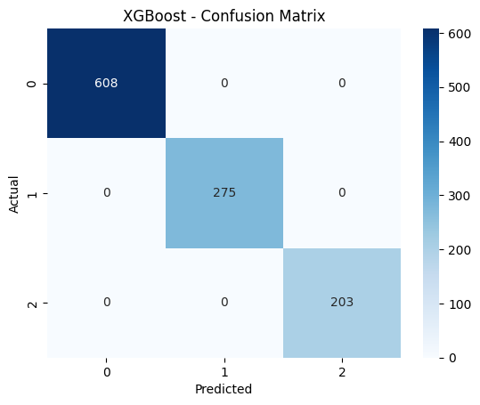
RF & XGBoost
Random Forest (RF)
Accuracy: ~100%
Comments: Learned embeddings very quickly; tends to overfit.
Confusion Matrix:
XGBoost
Accuracy: ~100%
Comments: Strong structured feature learner; stable performance.
Confusion Matrix:
RF and XGBoost performed extremely well on embedding-based features, but lacked temporal modeling capability — motivating the final choice of a hybrid LLM + LSTM architecture.

Slide 18
Hybrid modelling pipeline overview
Combines LLM embeddings (MiniLM-L6-v2) with LSTM-based sequence modeling for traffic congestion prediction.
The embedding model converts tweets into dense semantic vectors that preserve meaning, sentiment, and context.
Structured metadata features (sentiment score, time, geolocation approximations) are merged with embeddings.
The unified feature vector is passed into an LSTM network to learn temporal and contextual patterns.
Output layer predicts Low, Medium, or High congestion levels with probability scores.
Hybrid pipeline improves robustness over standalone ML models by using both semantic and contextual signals.

Slide 19
Model training & evaluation step
Train–Test Split:
Dataset divided into training and testing sets to ensure unbiased performance evaluation.
Model Inputs:
384-dimensional MiniLM embeddings
8 structured traffic-related features
Combined into a unified 392-dimensional vector for the LSTM model
Training Configuration:
Optimizer: Adam
Loss Function: Categorical Cross-Entropy
Batch Size & Epochs tuned for stability
Early stopping applied to prevent overfitting
Evaluation Metrics:
Accuracy, Precision, Recall, F1-score used to assess model’s predictive capability.
Outcome:
Hybrid model achieved high accuracy(~99.6%) and strong class separation, outperforming baseline ML models.

Slide 20
SHAP explainability
Perturbation-based analysis shows which MiniLM embedding dimensions influence congestion prediction the most.
Words related to accidents, crashes, blockage, jam, delay, and slow movement strongly shift predictions toward higher congestion.
Time-based features (hour, day, weekday) and sentiment polarity add contextual cues to refine classification.
Helps explain why the LSTM model predicted Low, Medium, or High congestion for a given tweet.
Enhances trust and interpretability for stakeholders like traffic authorities and reviewers.

Slide 21
GUI Overview
Built using Streamlit, provides a clean, interactive web-based interface for real-time testing and demonstration.
Allows users to input any tweet describing traffic conditions and instantly view:
Predicted congestion level
Probability distribution
Estimated delay in minutes
Processes multiple tweets at once, generates predictions, and offers download-ready output files.
Includes bar charts for prediction confidence and optional traffic density maps if coordinates exist.
Runs independently of the training pipeline, functioning solely for inference and demo purposes

Slide 22
Results summary
The hybrid LLM + LSTM model achieved ~99% accuracy on real-world traffic tweet data.
Successfully distinguishes between Low, Medium, and High congestion levels with strong probability confidence.
MiniLM embeddings produced well-separated clusters using HDBSCAN and K-Means.
Explainability methods highlighted key semantic drivers (accident, jam, blocked) that influence model predictions.
GUI tests confirmed consistent, stable predictions for both single and batch tweet inputs.

Slide 23
limitations
Training relied on ~6000–6500 tweets, which may not fully capture all traffic scenarios or rare events.
Some features (like coordinates and engagement metrics) were approximated during testing, not directly obtained from real data.
Model evaluated mostly on Vellore-related tweets; performance may vary for other cities with different traffic patterns.
MiniLM embeddings capture semantics well but may miss deeper contextual nuances compared to larger transformer models.
Sudden, high-impact traffic events might require more frequent retraining or additional real-time data sources.

Slide 24
Future enhancements
Integration with Live Traffic APIs:
Connect to real-time traffic feeds (Google Maps, TomTom, OpenTraffic) for continuous, dynamic updates.
Use of Larger LLM Models:
Upgrade from MiniLM to more powerful embeddings (e.g., BERT-base, RoBERTa, LLaMA-based encoders) for deeper semantic understanding.
Geotag Extraction from Raw Tweets:
Incorporate NLP-based location extraction for more accurate traffic mapping.
Multimodal Data Fusion:
Combine text with images, GPS streams, or CCTV feeds for richer congestion prediction.
Deployable Cloud API:
Convert the model into a scalable REST API using FastAPI or Flask for production-level traffic monitoring systems.
Interactive Analytics Dashboard:
Expand Streamlit UI into a full-featured dashboard with charts, timelines, and heatmaps.

Slide 25
conclusion
This project successfully demonstrates a hybrid approach combining LLM-based embeddings with LSTM modeling to predict traffic congestion from social media data.
The system effectively interprets real-world tweets, processes semantic and contextual features, and delivers accurate congestion classifications.
Clustering and visualization techniques validated the embedding quality, while the Streamlit dashboard enabled intuitive, user-friendly interaction.
Overall, the system provides a scalable foundation for intelligent traffic monitoring and can be extended into a fully operational smart city solution with real-time data integration and enhanced analytics.

